Slide 1
Hadoop

Slide 2

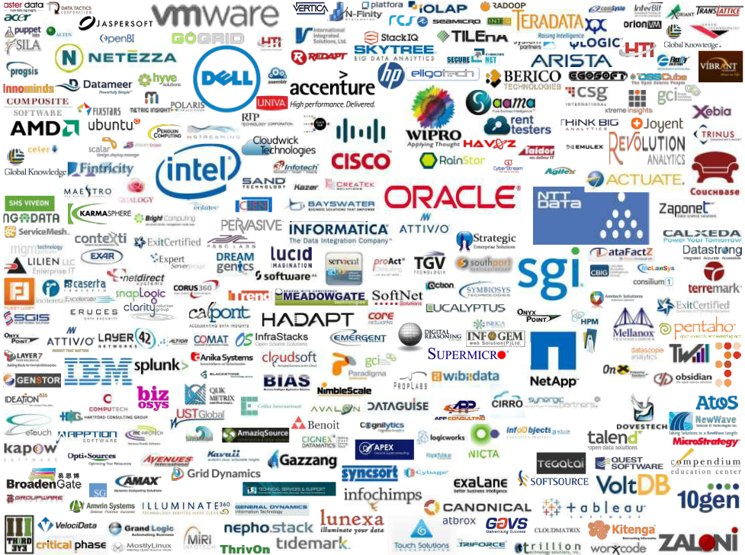
Moving Computation is Cheaper than Moving Data

Slide 3
Agenda
Need for a new processing platform (BigData)
Origin of Hadoop
What is Hadoop & what it is not ?
Hadoop architecture
Hadoop components (Common/HDFS/MapReduce)
Hadoop ecosystem
When should we go for Hadoop ?
Real world use cases
Questions

Slide 4
Need for a new processing platform (BigData)
What is BigData ?
- Twitter (over 7~ TB/day)
- Facebook (over 10~ TB/day)
- Google (over 20~ PB/day)
Where does it come from ?
Why to take so much of pain ?
- Information everywhere, but where is the
knowledge?
Existing systems (vertical scalibility)
Why Hadoop (horizontal scalibility)?

Slide 5
Origin of Hadoop
Seminar whitepapers by Google in 2004 on a new programming paradigm to handle data at internet scale
Hadoop started as a part of the Nutch project.
In Jan 2006 Doug Cutting started working on Hadoop at Yahoo
Factored out of Nutch in Feb 2006
First release of Apache Hadoop in September 2007
Jan 2008 - Hadoop became a top level Apache project

Slide 6
Hadoop distributions
Amazon
Cloudera
MapR
HortonWorks
Microsoft Windows Azure.
IBM InfoSphere Biginsights
Datameer
EMC Greenplum HD Hadoop distribution
Hadapt

Slide 7
What is Hadoop ?
Flexible infrastructure for large scale computation & data processing on a network of commodity hardware
Completely written in java
Open source & distributed under Apache license
Hadoop Common, HDFS & MapReduce

Slide 8
What is Hadoop
Framework for running applications on large clusters of commodity hardware
Scale: Petabytes of data on thousands of nodes
In Hadoop eco-system processing logic(Code) travels throughout the cluster and not the data.
Components
Storage: HDFS : Hadoop File System.
Name Node
SecondaryNameNode.
Data Node.
Job Tracker
Task Tracker
Processing.
Map
Reduce

Slide 9
What Hadoop is not
A replacement for existing data warehouse systems
A File system
An online transaction processing (OLTP) system
Replacement of all programming logic
A database

Slide 10
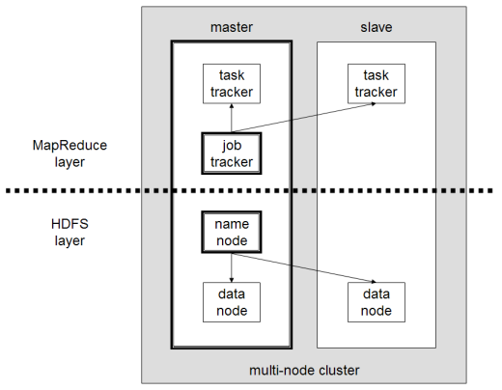
Hadoop architecture
High level view (NN, DN, JT, TT) –

Slide 11
Components of Hadoop
Namenode : stores and manages all metadata about the data present on the cluster, so it is the single point of contact to Hadoop.
Jobtracker : runs on the Namenode and perform the map reduce of the jobs submitted to the cluster
Secondarynamenode: maintains the backup of metadata present on the Namenode, file system change history.
Datanode: will contain the actual data.
Default Block Size in Datanode: 64MB
Tasktracker: will perform task on the local data, assigned by the Jobtracker.

Slide 12
HDFS (Hadoop Distributed File System)
Hadoop distributed file system
Default storage for the Hadoop cluster
NameNode/DataNode
The File System Namespace(similar to our local file system)
Master/slave architecture (1 master 'n' slaves)
Virtual not physical
Provides configurable replication (user specific)
Data is stored as chunks (64 MB default, but configurable) across all the nodes

Slide 13
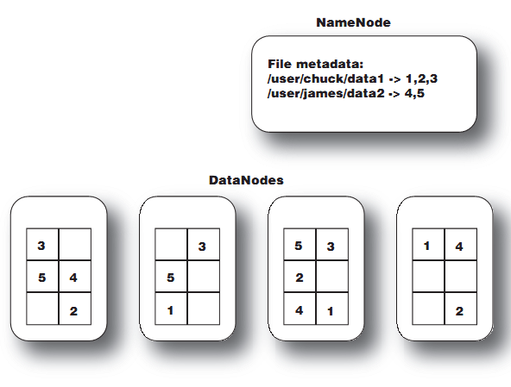
NameNode /DataNode interaction in HDFS
The NameNode keeps track of the file metadata—which files are in the system and how each file is broken down into blocks. The DataNodes provide backup store of the blocks and constantly report to the NameNode to keep the metadata current.

Slide 14
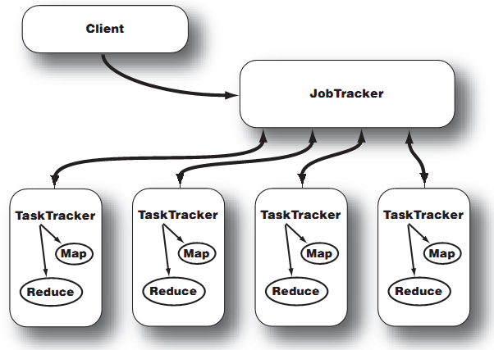
JobTracker and TaskTracker interaction
After a client calls the JobTracker to begin a data processing job, the JobTracker partitions the workand assigns different map and reduce tasks to each TaskTracker in the cluster.

Slide 15

HDFS architecture

Slide 16
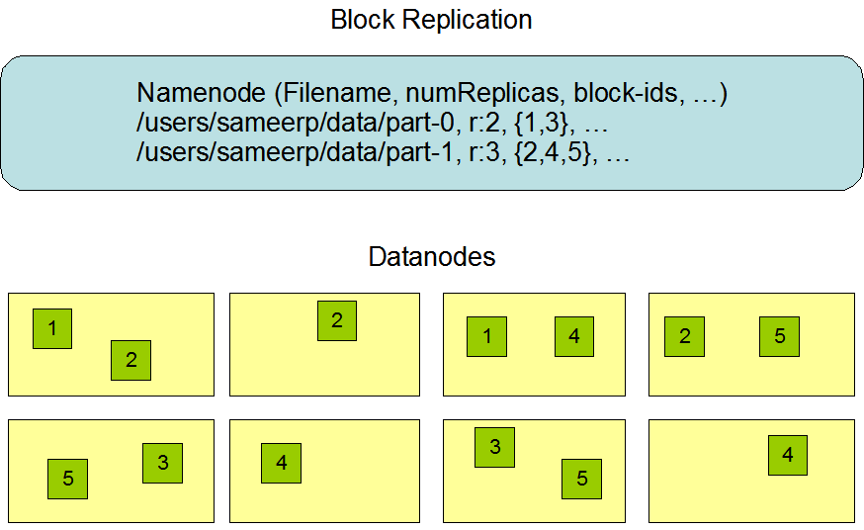
Data replication in HDFS.

Slide 17
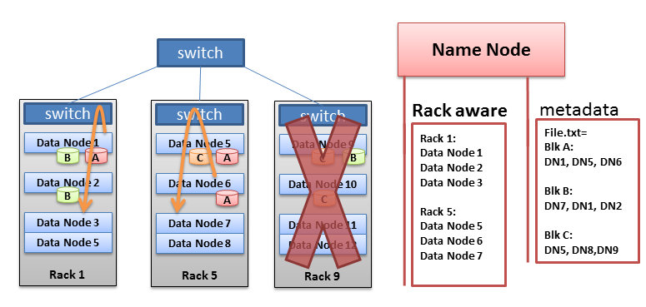
Rack awareness
Typically large Hadoop clusters are arranged in racks and network traffic between different nodes with in the same rack is much more desirable than network traffic across the racks. In addition Namenode tries to place replicas of block on multiple racks for improved fault tolerance. A default installation assumes all the nodes belong to the same rack.

Slide 18
MapReduce
Framework provided by Hadoop to process large amount of data across a cluster of machines in a parallel manner
Comprises of three classes –
Mapper class
Reducer class
Driver class
Tasktracker/ Jobtracker
Reducer phase will start only after mapper is done
Takes (k,v) pairs and emits (k,v) pair

Slide 19
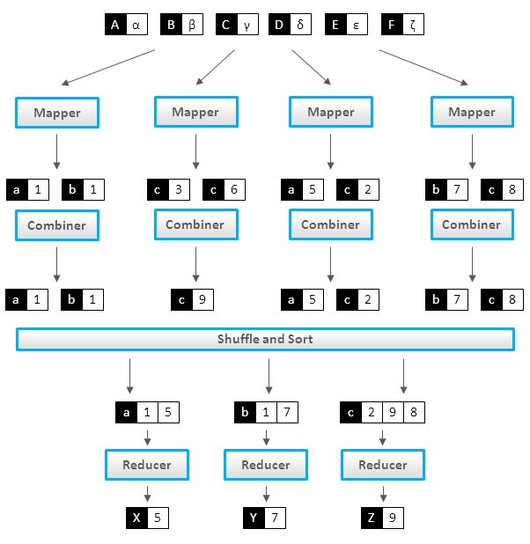
MapReduce structure

Slide 20
Modes of operation
Standalone mode
Pseudo-distributed mode
Fully-distributed mode

Slide 21
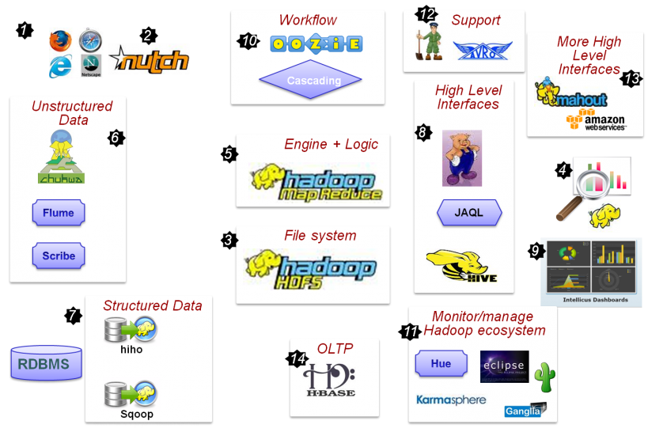
Hadoop ecosystem

Slide 22
Need of using hadoop
Need to process Multi Petabyte Datasets
Nodes fail every day
– Failure is expected, rather than exceptional.
– The number of datanodes in a cluster is not constant.
Need common infrastructure
– Efficient, reliable, Open Source Apache License
Workloads are IO bound and not CPU bound
Since the processing is distributed we don’t need high end processors.

Slide 23
Continue…
Very Large Distributed File System
Thousands nodes, millions of files, Petabytes of data.
Assumes Commodity Hardware
Files are replicated to handle hardware failure
Detect failures and recovers from them
User Space, runs on heterogeneous OS
Robustness:
Its all depends on heartbeat, every 3 seconds Datanode ping the Namenode for updates, if it does not do so Namenode mark it as dead node and data replication starts automatically

Slide 24
When should we go for Hadoop?
Data is too huge
Processes are independent
Online analytical processing (OLAP)
Better scalability
Parallelism
Unstructured data

Slide 25
Real world use cases
Clickstream analysis
Sentiment analysis
Recommendation engines
Ad Targeting
Search Quality
Notes:
Clickstream analysis:
Clickstream Technologies have developed a unique and disruptive technology that enables rule-based, intelligent alteration of web pages, in real-time, whilst the pages are in transit through the Internet between web servers and web browsers. The technology is independent of the type of browsing device or web server technologies deployed by users or publishers.
Sentiment analysis:
Sentiment analysis or opinion mining refers to the application of natural language processing, computational linguistics, and text analytics to identify and extract subjective information in source materials.
Generally speaking, sentiment analysis aims to determine the attitude of a speaker or a writer with respect to some topic or the overall contextual polarity of a document. The attitude may be his or her judgement or evaluation (see appraisal theory), affective state (that is to say, the emotional state of the author when writing), or the intended emotional communication (that is to say, the emotional effect the author wishes to have on the reader).
Recommendation engines:
A process of recomending better products or something that the customer is interested in.
Ad Targeting:
Analyging the user activities and targeting ad to the areas he is searching or interested in.
Search Quality :
Increasing search quality on the basis of user pereferences.

